Slide 1
What’s New in Azure Serverless
Abstract: Serverless is a great computing abstraction. When combined with great tools, developers can be more productive than ever. Developers are looking to leverage the new paradigm of serverless architecture: a scalable and reliable event-based compute experience for code and workflows, which accelerate the development of applications while eliminating the need to manage infrastructure, providing fast auto-scale and micro-billing. In this session, we will explore the use of Azure Functions, Event Grid, and Logic Apps for building powerful serverless applications. We will learn how to build, deploy, manage, and monitor those solutions. This session will quickly cover the basics, and finish with a look at the newest features in the Azure Serverless platform.

Slide 2
What’s New in Azure Serverless
Michael S. Collier
Sr. Software Development Engineer
Commercial Software Engineering – Global ISV
@MichaelCollier | www.MichaelSCollier.com

Slide 3
Agenda
What is Serverless on Azure?
Azure Functions
Azure Logic Apps
Azure Event Grid
Q&A

Slide 4
The “evolution” of application platforms
Notes:
All good things begin with a story.
So before I talk to you about serverless, I wanted to discuss some history of how apps have been built through the years and how that has led us to the computing options we have today.
Buy your own hardware and software
Run it in your own data-centers
Deal with a multitude of questions
# of servers
Physical security
Hardware failure
Software patching
Backup
Essentially a lot of questions, not all of which might be directly related to running your business. For example, if you are running an insurance company, you want to spend your time growing and innovating in the insurance domain, not worrying about how to handle servers.

Slide 5
What is the right size of
servers for my business needs?
How do I deploy new code to my server?
What media should I
use to keep backup?
What happens in case of
server hardware failure?
Which packages should be on my server?
What size of servers
should I buy?
Who monitors
my App?
How often should I backup my server?
How can I scale my app?
How can I increase server utilization?
Who has physical
access to my servers?
Which OS should I use?
Do I need secondary network connection?
Are my server in a
secure location?
What happens if the
power goes out?
Who monitors
my Servers?
Do I need a UPS?
What storage I need to use?
How many servers
do I need?
How can I dynamically configure my app?
It takes how long to provision a new server?
How often should
I patch my servers?
On-Premises
The “evolution” of application platforms
Notes:
All good things begin with a story.
So before I talk to you about serverless, I wanted to discuss some history of how apps have been built through the years and how that has led us to the computing options we have today.
Buy your own hardware and software
Run it in your own data-centers
Deal with a multitude of questions
# of servers
Physical security
Hardware failure
Software patching
Backup
Essentially a lot of questions, not all of which might be directly related to running your business. For example, if you are running an insurance company, you want to spend your time growing and innovating in the insurance domain, not worrying about how to handle servers.

Slide 6
What is the right size of servers for my business needs?
How can I increase server utilization?
How many servers do I need?
How can I scale my app?
How often should I patch my servers?
How do I deploy new code to my server?
How often should I backup my server?
Which OS should I use?
Which packages should be on my server?
Who monitors my App?
On-Premises
IaaS
The “evolution” of application platforms
Notes:
Along came the cloud, and provided some relief from some of those questions.
IaaS in the cloud, allowed you to forget about managing all that physical hardware. Instead of hosting it yourself, you could now utilize servers hosted by someone else. While the worries around managing physical infrastructure are gone, there are a number of questions that still need to thought about:
How many virtual machines do I need?
How many would I need in future when my usage grows?
How to handle updating the servers for the latest security patches
How to think about deploying my code and the various dependencies, such as application runtimes, to the server
Who monitors my apps and so on
This means that you still haven’t reached that ideal state where you could focus purely on your business and its problems.

Slide 7
What is the right size of “servers” for my business needs?
How can I increase “server” utilization?
How many “servers” do I need?
How can I scale my app?
On-Premises
IaaS
PaaS
The “evolution” of application platforms
Notes:
Well, the cloud continue to help with that problem and with the advent of PaaS, there was even more simplification. PaaS allows you to just worry about your app, and let the cloud vendor take care of not only the physical hardware, but also the ongoing management of the operating environment like Operating Systems, Virtual Machines or Containers, as well as the various application runtimes, whether it is Java Runtime, .NET, Node.js, and so on.
You are not completely free from thinking about servers however, since you still have to worry about how to scale your app and accordingly specify the number and size of the various compute resources your apps would need at various times.

Slide 8
How do I architect my app?
Serverless, the platform for next gen apps
On-Premises
IaaS
PaaS
Serverless
The “evolution” of application platforms
Notes:
The latest in this series of evolution is Serverless – which further abstracts the underlying infrastructure from you, and allows you to focus only on a single question – how are you going to build your app to achieve the best results for your business, or whatever it is that you are trying to do with your apps.
Whether it is the code to delight your customers through a great experience, or the logic to communicate securely with a business partner, that is where most organization want to spend their creative energies on.
And serverless allows you to do just that, focus on your code and forget about the infrastructure.
This is why we believe it is the platform for next generation of apps.

Slide 9
What is “serverless”
Abstraction of servers
Event-driven scale
Sub-second billing
Notes:
Abstraction of servers, infrastructure and configuration of operating system
Event-driven scale
Sub-second billing
Stateless

Slide 10
Benefits of “serverless”
Micro-pricing
Ease of scale
Manage less
Notes:
“Pinnacle of PaaS compute”
Not just hardware “servers”, but software servers are also managed for you
Focus on business logic, not solving technical problems not core to business
Lower effort to get started makes it easier to experiment (bots, etc.)

Slide 11
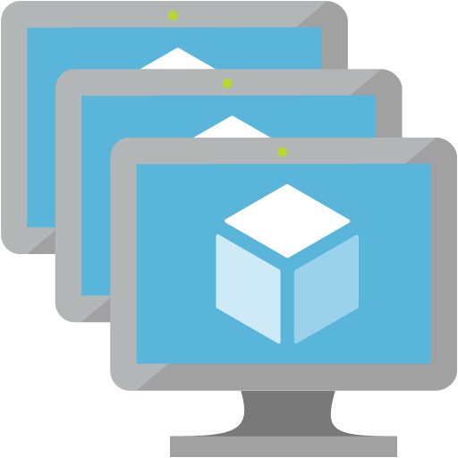
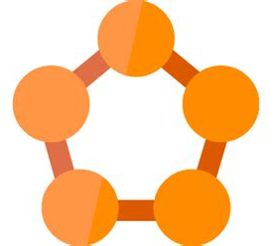


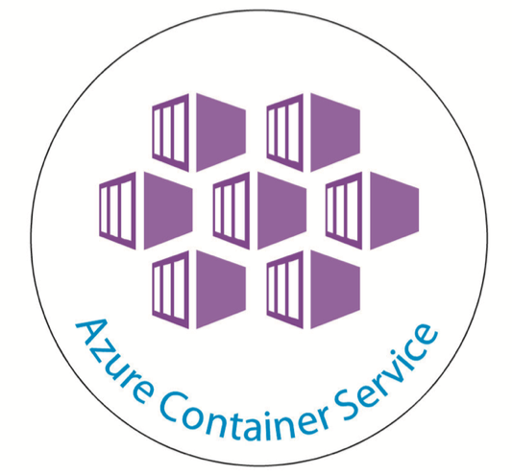

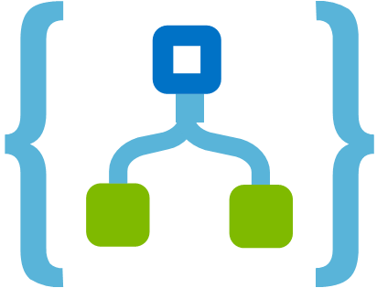
Azure Compute Options
IaaS
PaaS
Serverless
Azure Virtual Machines VM Scale sets Azure Container Service
Azure App Service Service Fabric (sort of) Azure Batch
Azure Functions Logic Apps Event Grid

Slide 12
Azure Compute Options
IaaS
PaaS
Serverless
Control
Productivity

Slide 13



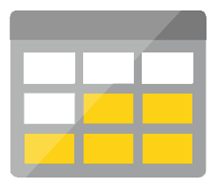
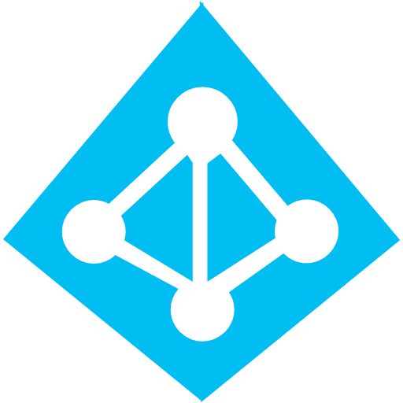



Serverless application platform components
Development
Platform
IDE support
Event Grid
Logic Apps
Functions
Manage all events that can trigger code or logic
Design workflows and orchestrate processes
Execute your code based on events you specify
Integrated DevOps
Local Development
Monitoring
Database
Storage
Security
IoT
Analytics
Intelligence
Visual Debug History

Slide 14


Functions
Code
Azure Functions
Events & Data
Develop locally using best of class developer tools
Boost productivity through triggers and bindings
Choose from a variety of programming languages
Integrate with existing DevOps processes
Notes:
We already saw how Functions provide an experience of responding to events through code that in turn processes data that could be coming from or headed to any number of services. Some of the key highlights are:
Ability to build, test and debug your Functions code locally on your own machine before your code is even deployed to the cloud. This is a massive productivity benefit while building cloud applications and something Azure provides through rich integration with a world class developer tool like Visual Studio
Secondly, unique features like triggers and bindings that make it super easy to setup event-driven architectures and simplify communication with data sources
Thirdly, we support a number of programming languages. In the demo we saw an example with C#. But we also support Node.js, F#, Python and even bash so you can pick the language of your choice to write serverless functions with
Lastly, Functions support concepts such as Continuous deployment, which makes it super easy to integrate them into your existing DevOps pipelines.

Slide 15

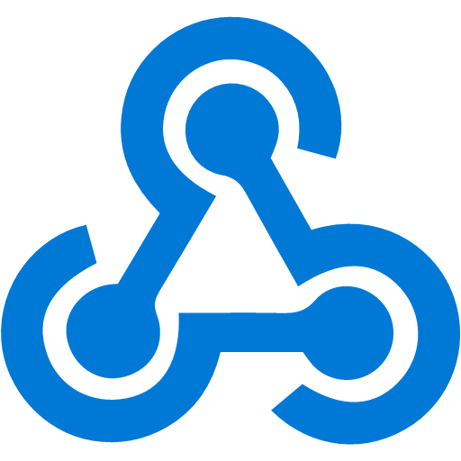







Azure Functions
Events
Code
Outputs
React to timers, HTTP, or events from your favorite Azure services, with more on the way
Author functions in C#, F#, Node.JS, Java, and more
Send results to an ever-growing collection of services

Slide 16
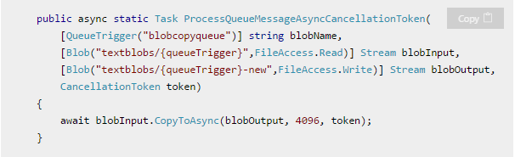
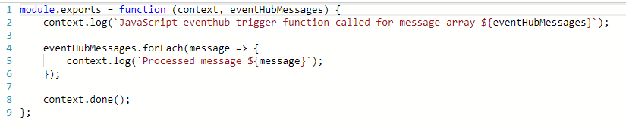
What is the “Functions” programming model?
Function as the unit of work
Functions are executed; they start and finish
Functions have triggers
Functions can have inputs and outputs (bindings)
Notes:
First, a simple event hub JS function (just trigger)
Then, a good example of a C# function with a trigger and input/output bindings

Slide 17
Language Support
Language | 1.x | 2.x | Notes
C# | GA | Preview | C# Script and Class Libraries
JavaScript | GA | Preview | Node, 6.50 (1.x) and >=8.4.0 (2.x)
F# | GA | Preview | F# Script and Class Libraries
Java |  | Preview | Maven, Jenkins, Eclipse, VS Code Supported
Python | Experimental | Soon
Bash | Experimental
PowerShell | Experimental
Batch | Experimental
PHP | Experimental
TypeScript | Experimental
Experimental languages don’t scale well & limited binding support; no official support.
Notes:
https://docs.microsoft.com/en-us/azure/azure-functions/supported-languages

Slide 18
Demo
Functions
Notes:
Deploy via visual studio, GitHub, or Zip? Zip!
Show Application insights
https://docs.microsoft.com/en-us/azure/azure-functions/functions-monitoring
https://docs.microsoft.com/en-us/azure/azure-functions/deployment-zip-push

Slide 19



Function Proxies
Customers
customers.azurewebsites.net
Present a single API surface
Modify requests & responses
Mocking
Reference request & response parameters as variables
Lightweight API Management
Products
products.azurewebsites.net
API calls
Orders
orders.azurewebsites.net
Function app B
/products
Function2
Function app A
/customers
Function1
/products
Function app C
/orders
/orders
Function3

Slide 20

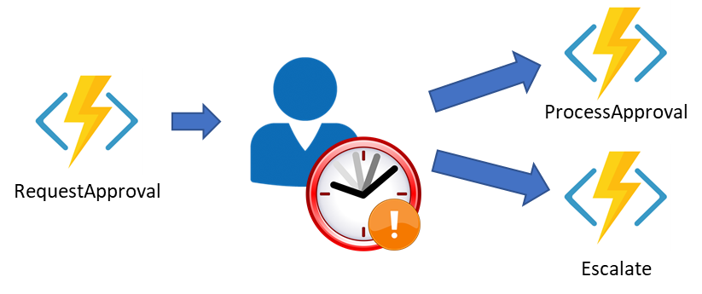
Durable Functions
1
F1
F2
F3
F4
Extension of Azure Functions & WebJobs
Orchestrator Function
Call functions sync/async
Automatic checkpoints
2
Start
DoWork
3
GetStatus
F1
F3
F2
4
5
Notes:
1 – Function Chaining
2 – Fan-out / fan-in
3 – Async HTTP APIs
4 – Stateful singletons
5 – Human interaction
https://github.com/Azure/azure-functions-durable-extension/releases/tag/v1.2.0-beta3

Slide 21

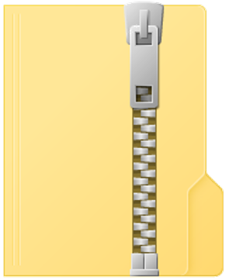
What’s new in Azure Functions
Trigger a function based on changes in Cosmos DB
Database
Local Development
Develop functions locally on Linux, MacOS, Windows
Functions
Long running, stateful functions
Execute your code based on events you specify
Durable Functions
Securely provide access to information in Microsoft Graph through a function
Security
Monitoring
Monitor serverless applications using Application Insights
Trigger a function from a real-time analytics pipeline in Stream Analytics
Analytics
Deployment
Zip-push
Notes:
https://docs.microsoft.com/en-us/azure/azure-functions/deployment-zip-push#deployment-customization

Slide 22


Henrik Fransas Lab: Episerverless = Azure Functions + Episerver 3:15pm today ROOM???
System developer since 1999
Episerver Most Valuable Professional (EMVP)
Episerver Technical Trainer
Azure nerd
Works at NetRelations

Slide 23
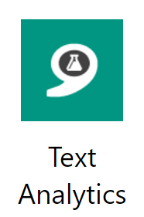
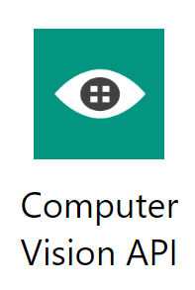
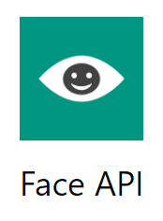


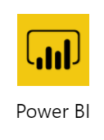

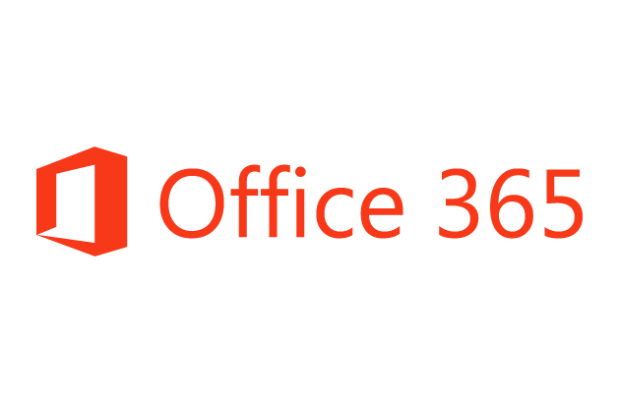

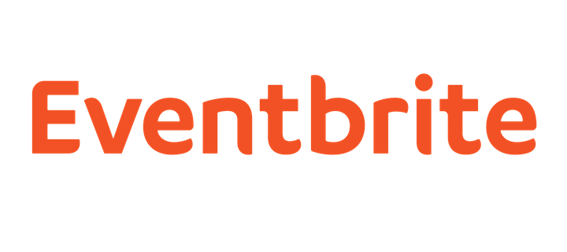










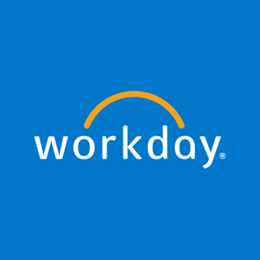

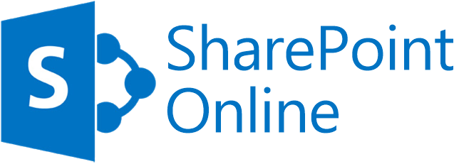



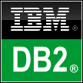


Logic Apps connects everything*
Azure API Management
Azure Service Bus and Event Grid
Azure Functions
Azure Active Directory
Azure App Services
Azure Blob
Azure CosmosDB
Azure Data Lake
Azure SQL
Azure Resource Manager
Logic Apps
On-premises data
gateway
BizTalk Server
* Everything is a lot! There are more than 200 connectors and ability to create custom connectors.
Notes:
Logic Apps support more than 180 connectors already. It goes without saying that it supports most Azure services but you can see from this list that it also supports many popular 3rd party services like Dropbox, Twitter, Salesforce and so on.
And it does that without requiring you to understand how any of these other services work. It completely abstracts the integration details of how to communicate with these other services and their specific API, SDKs and protocols.

Slide 24
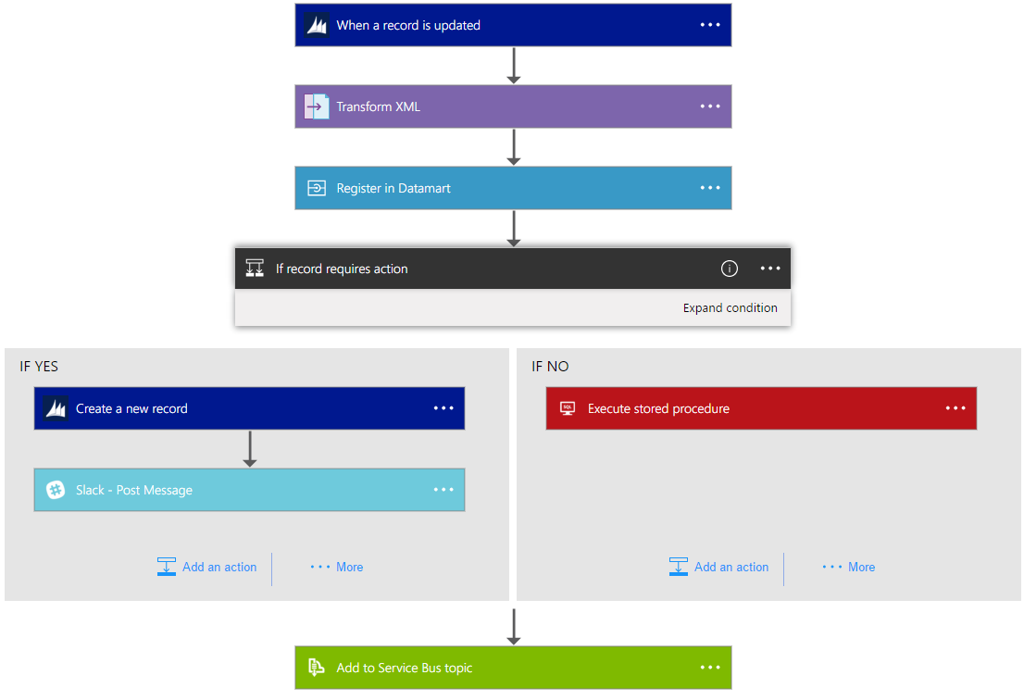
Logic Apps Workflow Designer
Workflow in the cloud
Powerful control flow
Connect disparate applications
No code designer for rapid creation
Also works within Visual Studio for added CI/CD
Notes:
Moving on to Logic Apps
Logic Apps is a service that provides a visual design experience for creating serverless workflows in the cloud without writing any code.
No matter how complex your business logic is, you can express it using the powerful control flow available in Logic Apps.
Another key value of this service is that, it provides connections with multiple services and allows you to orchestrate all these services along with the functions which you or someone else in your organization might have written.
Lastly all of these workflows are internally represented using a declarative definition format, again making it very friendly with your existing CI/CD practices

Slide 25
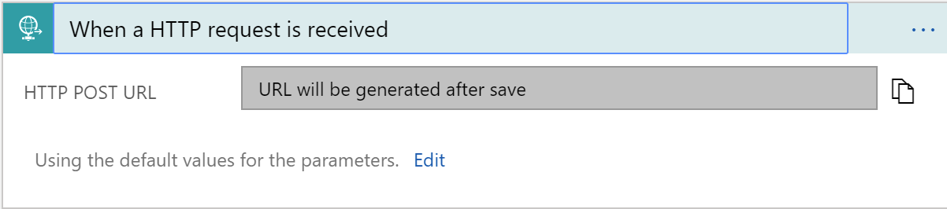
Triggers
All logic apps start with a trigger, typically a connector
Recurring and Adv. Scheduling
Polling
Webhook
Request

Slide 26
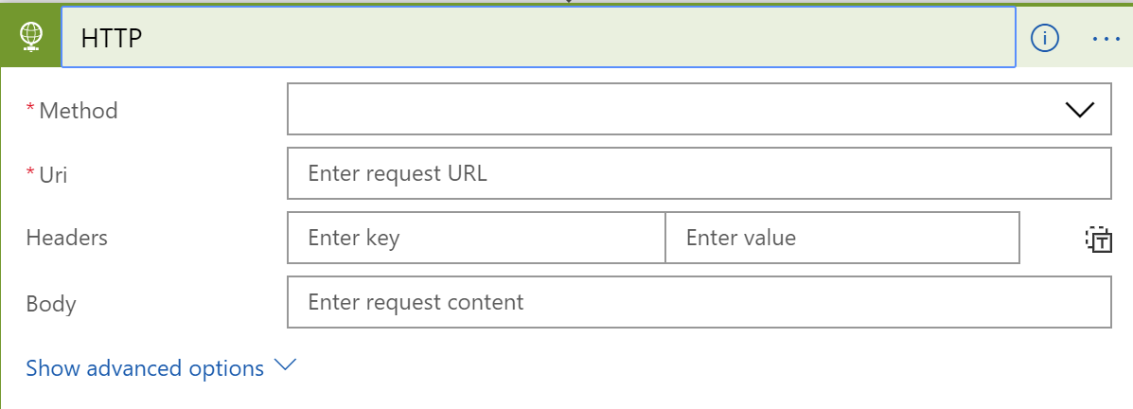
Actions
All logic apps continue with actions, which is also most of the time, a connector
Invoke APIs and Services
Behaviors
Variables
Expressions and Operators

Slide 27
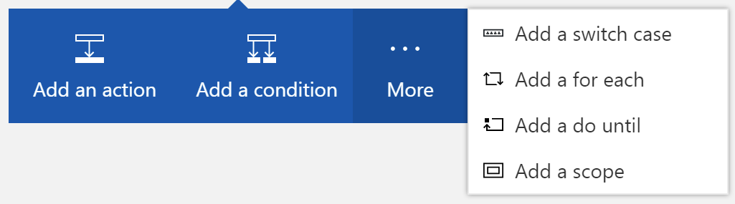
Workflow Features
To control your logic app's workflow, you can specify different paths for your logic app to run and how to process data in arrays, collections, and batches

Slide 28
Demo
Logic Apps
Notes:
Show image processing logic app
Watch for files
Analyze with computer vision
Create thumbnail with computer vision
Send text message

Slide 29
Azure Event Grid
Fully-managed event routing
Near real-time event delivery at scale
Broad coverage within Azure and beyond
Backbone of event-driven computing
Notes:
Now, I would like to spend some time discussing the newest member of the Azure Serverless family, Azure Event Grid.
If you’ve done any UI work in the past, you might be familiar with delegates and event-driven programming. This has been a solved problem for a long time within application, now it is finally coming to the cloud.
In terms of performance and scale, Event Grid makes some strong guarantees.
Sub-second e2e latency in the 99th percentile, which is as close to real-time delivery as it gets
An ability to route about 10 million events per second, so massive scale
And, an intelligent logic to retry the event delivery if the first time doesn’t succeed
All of these make Event Grid a very powerful event backbone for your serverless applications.

Slide 30


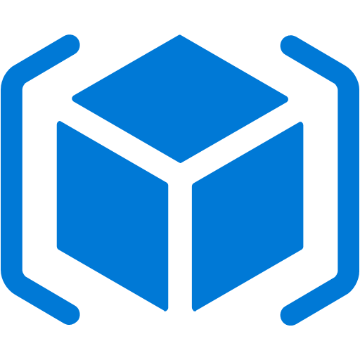
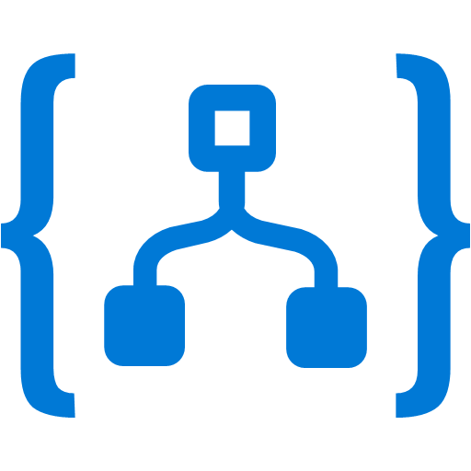





Event Grid
Event publishers
Event handlers
Blob Storage
Manage all events in one place
Focus on innovation and pay per event
Unlock new scenarios for your apps
Ensure reliability and performance for your apps
.NET, Go, Node, Python, & Ruby SDKs
99.99% publish availability SLA
new
Storage (GPv2)
Azure Functions
Resource Groups
Logic Apps
Azure Subscriptions
Azure Automation
Event Hubs
WebHooks
new
new
Service Bus
Event Hubs
new
new
IoT Hub
Event Subscriptions
new
Custom Topic
Topics
Notes:
We already talked about how important events are.
This service allows you to manage all events in a single place
Notice that multiple Azure services today publish their events into Event Grid and these events can be routed to multiple destination. We have Functions, Logic Apps and even other services like Automation and generic webhooks.
You can also create your own customer events
The rich set of publishers and consumers opens up many interesting scenarios for you to construct already. And the list of services that will publish their events to Event Grid will continue to grow over time.
https://azure.microsoft.com/en-us/blog/azure-service-bus-now-integrates-with-azure-event-grid/

Slide 31
Event Schema
[{
"topic": "/subscriptions/{subscription-id}/resourceGroups/mcollier-ascend/providers/Microsoft.Storage/storageAccounts/mcollierascend",
"subject": "/blobServices/default/containers/sample/blobs/michael.collier.jpg",
"eventType": "Microsoft.Storage.BlobCreated",
"eventTime": "2018-03-08T02:32:32.3138466Z",
"id": "60b827dd-701e-010a-2e85-b6ba5f0618c4",
"data": {
"api": "PutBlockList",
"clientRequestId": "580ebc71-0b38-4e13-9c3e-5db169ad2032",
"requestId": "60b827dd-701e-010a-2e85-b6ba5f000000",
"eTag": "0x8D5849CD8572590",
"contentType": "image/jpeg",
"contentLength": 687245,
"blobType": "BlockBlob",
"url": "https://mcollierascend.blob.core.windows.net/sample/michael.collier.jpg",
"sequencer": "0000000000000000000000000000043C00000000004b90e3",
"storageDiagnostics": {
"batchId": "11c2a1b3-013f-4c7a-a31e-cf455a2c7d3f"
}
},
"dataVersion": "",
"metadataVersion": "1"
}]
Properties specific to the publisher
https://docs.microsoft.com/en-us/azure/event-grid/event-schema
Notes:
What does an event look like? It’s really pretty basic.
https://github.com/Azure/azure-rest-api-specs/tree/master/specification/eventgrid/data-plane
https://docs.microsoft.com/en-us/azure/event-grid/event-schema

Slide 32
Demo
Event Grid
Notes:
.NET SDK
REST
Custom Topic
Blob Created / Deleted
Azure CLI

Slide 33

What’s new in Event Grid
10 major regions (Asia, US, Europe)
Storage (GPv2), Service Bus, IoT Hub
New Event Publishers
Geographic Availability
Event Grid
Financial Backed SLA
99.99% publish availability
Manage all events that can trigger code or logic
New Event Handler
$
Event Hubs
Management & Publish SDKs
.NET, Go, Node, Python, Ruby & Java (soon)
24 hr. exponential back off
Retry Policy
{ }

Slide 34




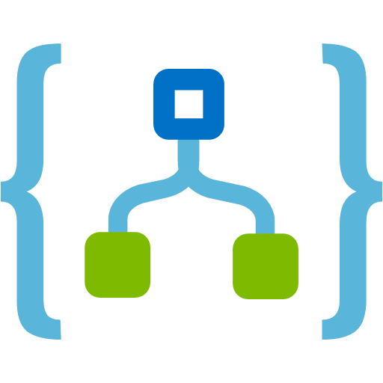
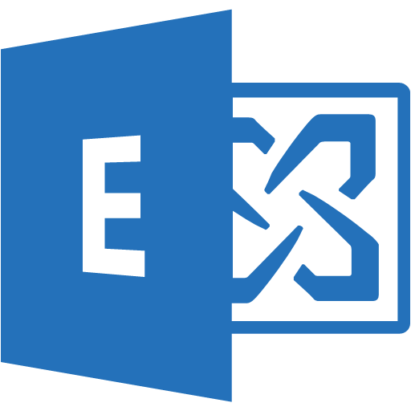
Demo – Altogether
http://github.com/Azure-Samples/customer-car-reviews
Website - SPA
Website Backend
Proxy
Car Review
GetCars
CreateCar
UploadFile
User
Try it at https://aka.ms/ascend-cars
Blob Storage
Cosmos DB
Reviews Service
Event Grid
Logic App
Office 365
Content Moderator
ChangeFeed
CheckImage
CheckText
SendEvent
Computer Vision

Slide 35
Resources
https://aka.ms/serverless-demos
http://azure.com/EventGrid
https://docs.microsoft.com/en-us/sandbox/functions-recipes/
https://github.com/Azure/Azure-Functions

Slide 36
Henrik Fransas Lab: Episerverless = Azure Functions + Episerver 3:15pm today ROOM???
System developer since 1999
Episerver Most Valuable Professional (EMVP)
Episerver Technical Trainer
Azure nerd
Works at NetRelations

Slide 37
Microsoft Build
May 7-9, 2018 // Seattle, WA
BuildWindows.com

Slide 38


Thank You!

Slide 39
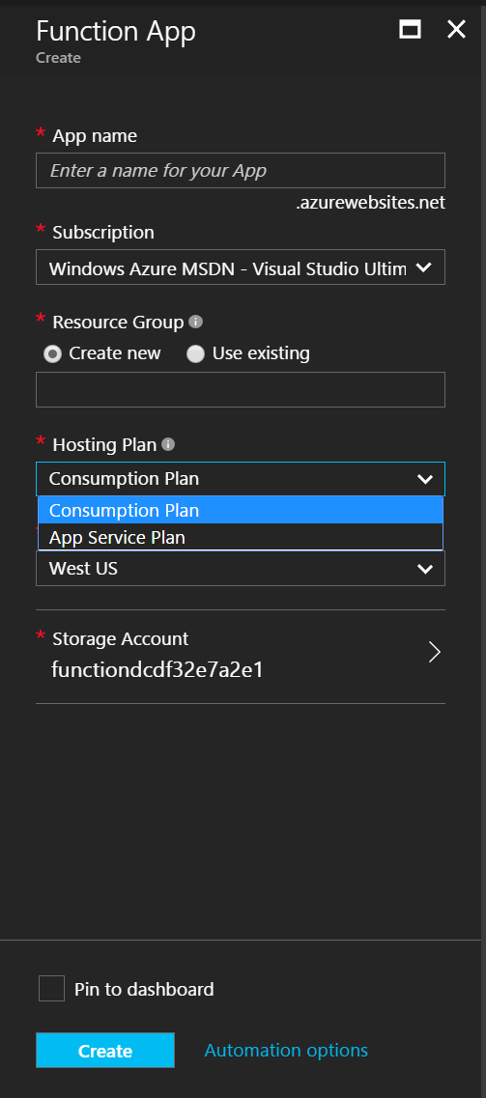
Consumption Plan
The Consumption Plan option
Pay for what you use without the need to reserve compute resources.
Function Apps are assigned to compute processing instances that are scaled dynamically by the platform.
Functions can have multiple parallel executions minimizing the total time needed to process requests.
Cost is driven by the number of executions and by accounting for memory size used and total execution time across all functions in a Function App as measured in gigabyte-seconds.
Selection guidance
Good option if your functions run at elastic scale with potentially intermittent executions.

Slide 40
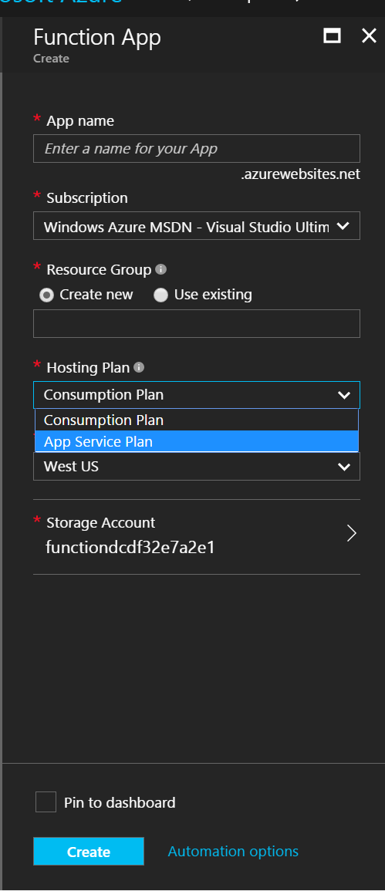
App Service Plan
The App Service Plan option
Function Apps run on dedicated VMs, just like Web Apps work today for Basic, Standard, or Premium SKUs.
Dedicated VMs are allocated to your apps and they are always available whether code is being actively executed or not.
Selection guidance
Good option if you have existing, under-utilized VMs that are already running other code
or
Good option if you expect to run functions continuously or almost continuously

Slide 41
Runtimes and Languages – V1 Runtime (GA)
Host runs .NET Framework 4.6.1
C#/F# Functions run in same host process (.NET Framework 4.6.1)
Node.js also runs in same host process (using Edge – LOCKED at Node 6.5.0)
A few other “experimental” languages that also run in process. Not a scalable model.
Python, Bash, PowerShell, Batch, PHP, TypeScript
Notes:
When you create Functions today, you default to the V1 runtime. It’s great for C# and F# functions, but a big limitation is that due to running Node.JS in the host process, the version of Node you can use is locked at 6.5.0.

Slide 42
Runtimes and Languages – V2 Runtime (Preview)
Host runs .NET Core 2.0
C#/F# Functions run in same host process (.NET Core 2.0)
New extensibility model for languages where “language workers” run out-of-process.
Node.js – defaults to 8.4.0 but now can opt in to newer versions
Java
Python (early in progress)
Other languages in discussion / investigation
New extensibility model for bindings
Lighter core runtime
Version control
Today requires you manually “func extensions install” to use bindings / triggers
Notes:
Our V2 runtime has a number of improvements:
Our host runs .NET Core 2.0
While C# and F# still run in the same host process, we have a new extensibility model for other languages.
Language workers run out of process.
This means that if you want to go out and write a language worker for Ruby or Go, you can do so. We have information available in the azure-webjobs-sdk-script GitHub repo’s wiki.
We have an extensibility model for bindings, which we’ve made more declarative as well, and we’ve centralized some of the binding logic that used to have to be implemented per-extension.
V2 is still in preview, but we anticipate a GA release later this year. You can try it out by setting your FUNCTIONS_EXTENSION_VERSION app setting to beta in the portal, or installing the latest Azure Functions and Web Jobs Tools in Visual Studio.
There are also cool new features being developed for V2, including Durable Functions, which I’ll focus on for the rest of this talk.

Slide 43



order
process order
ship it
custom topic event
site telemetry

Slide 44



Ways to Run Functions
Consumption
Serverless
App Service Plan
Free, Basic, Standard, Premium
App Service Environment
Network Isolation
Azure Stack
On Premises
Azure Functions Runtime (preview)
Functions on your Server
Pay only for what you use! Metering is per execution and per GB Second.
All the advantages of Functions with the SLA and ‘always on’ features of an App Service Plan.
Your own dedicated cloud environment with network isolation for apps, higher scale, and the ability to connect securely to local vNets.
Leverage cloud innovations in on-premises infrastructure. Azure Stack brings the power of Azure to your own data centers.
Run your Azure Functions on your local server (without the rest of Azure)

Slide 45
Comparing Messaging Services
Event: Lightweight notification of an action or state change
Message: Raw data produced by a service to be consumed or stored elsewhere
Service | Purpose | Type | When to use
Event Grid | Reactive programming | Event distribution | React to status change
Event Hubs | Big data pipeline | Event streaming | Telemetry & distributed data streaming
Service Bus | High-value enterprise messaging | Message | Order processing & financial transactions
order
process order
ship it
custom topic event
site telemetry
Notes:
https://docs.microsoft.com/en-us/azure/event-grid/compare-messaging-services
In some cases, you use the services side by side to fulfill distinct roles. For example, an ecommerce site can use Service Bus to process the order, Event Hubs to capture site telemetry, and Event Grid to respond to events like an item was shipped.
In other cases, you link them together to form an event and data pipeline. You use Event Grid to respond to events in the other services. For an example of using Event Grid with Event Hubs to migrate data to a data warehouse, see Stream big data into a data warehouse. The following image shows the workflow for streaming the data.

Slide 46
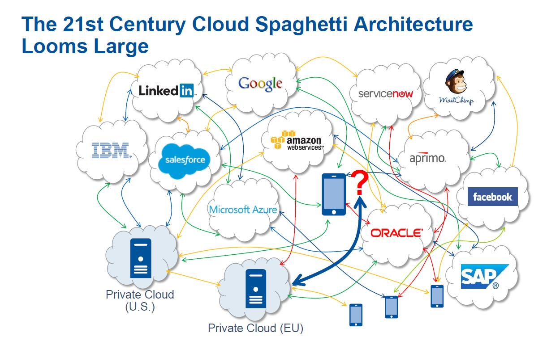
With great power comes great responsibility
Notes:
https://twitter.com/udidahan/status/971650599220588544?s=21

Slide 47
Event Grid delivers at massive scale
Sub-second end-to-end latency in the 99th percentile
10,000,000 events per second per region
24-hour retry with exponential back off for events not delivered
Near real-time
Massive scale-out
High reliability
Notes:
In terms of performance and scale, Event Grid makes some strong guarantees.
Sub-second e2e latency in the 99th percentile, which is as close to real-time delivery as it gets
An ability to route about 10 million events per second, so massive scale
And, an intelligent logic to retry the event delivery if the first time doesn’t succeed
All of these make Event Grid a very powerful event backbone for your serverless applications.

Slide 48
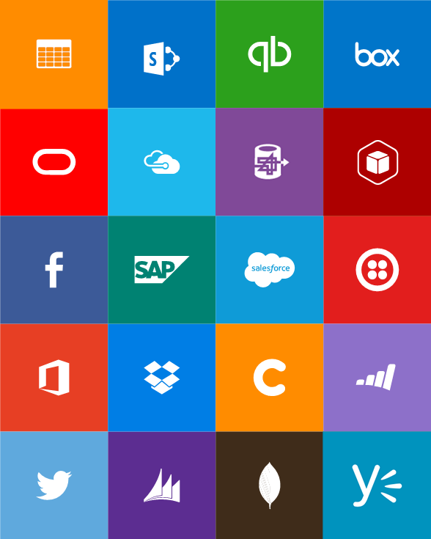
Out-of-box connectors
SaaS
Azure Service Bus
Azure Storage Blob
Bing Search
Box
Dropbox
Dynamics CRM Online
Facebook
GitHub
Google Calendar
Google Drive
Google Sheets
Google Tasks
Instagram
MailChimp
Mandrill
Microsoft Project Online
Microsoft Translator
Office 365
Office 365 Users
OneDrive
OneDrive for Business
Outlook.com
Project Online
Salesforce
SendGrid
SharePoint Online
Slack
SparkPost
SQL Azure
Trello
Twilio
Twitter
VSTS
Wunderlist
Yammer
YouTube
Protocols
Enterprise messaging
Hybrid
HTTP, HTTPS
HTTP Webhook
FTP, SFTP
SMTP
RSS
Delay
Workflow
Validate
Transform (+Mapper)
Convert (XML-FF)
X12
EDIFACT
AS2
IBM DB2
Informix
SharePoint Server
SQL Server
Websphere MQ

Slide 49
Azure Functions is an Open Source project
https://github.com/Azure/Azure-Functions
Azure Functions Host - the Azure Functions runtime
Azure WebJobs SDK - the "core" of the Azure Functions runtime and many bindings
Azure WebJobs SDK extensions - the repositories of many bindings
Azure Functions CLI - the command line tool for Azure Functions
Azure Functions Portal - the UX for the Functions development portal
Azure Functions templates - the templates which show up the Azure Functions portal
Azure Functions samples - repository for some samples on how the runtime works

Slide 50
protected static void SendToEventGrid()
{
string endpoint = "dspevents.westus-1.eventgrid.azure.net";
string sharedAccessKey = "PI4dKlXLoskg8EIhCGRS6Owcr5mtvNzAnuC0FWgrfJQ=";
string publisherAddress = $"https://{endpoint}:443/api/events";
var myEventList = new List<GridEvent>
{
new GridEvent
{
Id = Guid.NewGuid().ToString(),
Subject = $"customer/Nestle",
EventType = "CustomerPaid",
EventTime = DateTime.UtcNow,
Data = new{TenantId="123455", ContactId="foo232342"}
},
new GridEvent
{
Id = Guid.NewGuid().ToString(),
Subject = $"customer/Hershey",
EventType = "CustomerCreated",
EventTime = DateTime.UtcNow,
Data = new{TenantId="123455", ContactId="foo232342"}
}
};
using (var httpContent = new StringContent(JsonConvert.SerializeObject(myEventList)))
{
httpContent.Headers.Add("aeg-sas-key", sharedAccessKey);
using (var httpClient = new HttpClient())
{
using (var httpResponseMessage = httpClient.PostAsync(publisherAddress, httpContent).Result)
{
Console.WriteLine($"Reponse status code: {httpResponseMessage.StatusCode}");
}
}
}
}
private static async Task SendToEventGridWithSdk()
{
string topicKey = "PI4dKlXLoskg8EIhCGRS6Owcr5mtvNzAnuC0FWgrfJQ=";
TopicCredentials credentials = new TopicCredentials(topicKey);
EventGridClient client = new EventGridClient(credentials);
string topicHostname = "dspevents.westus-1.eventgrid.azure.net";
IList<EventGridEvent> events = new List<EventGridEvent>
{
new EventGridEvent
{
EventTime = DateTime.UtcNow,
Id = Guid.NewGuid().ToString(),
Subject = "customer/Nestle",
DataVersion = "1.0",
EventType = "CustomerCreated",
Data = new {TenantId = "112345", ContactId = "foo34343"}
},
new EventGridEvent
{
EventTime = DateTime.UtcNow,
Id = Guid.NewGuid().ToString(),
Subject = "customer/Nestle",
DataVersion = "1.0",
EventType = "CustomerStarted",
Data = new MyData{FirstName = "Michael", LastName = "Collier"}
}
};
await client.PublishEventsAsync(topicHostname, events);
}

Slide 51
Guideance
Use App Insights EVERYTIME
Do as little work synchronously as possible
Trigger in batches – and catch exceptions
Global static variables for things like HttpClient and DocumentClient
Use a DevOps pipeline such as VSTS
Can also do GitHub / Source Control deploy for “simple” CI/CD

Slide 52
Function Chaining
Async HTTP APIs
F1
F2
F3
F4
Start
DoWork
Stateful Singletons
GetStatus
Fan-Out / Fan-In
Human Interaction
F1
F3
F2

Slide 53
Deployment and management isolation
Customers
customers.azurewebsites.net
Products
products.azurewebsites.net
API calls
Orders
orders.azurewebsites.net

Slide 54
Function app B
/products
Function2
Function app A
/customers
Function1
/products
Function app C
/orders
/orders
Function3
Key:
HttpTrigger function endpoints
API proxy endpoints

